Slide 1
Consumer Behavior
MARK60550, CRN 29351, MW 3:00-4:50, Spring 2
Joe Cherian, PhD

Slide 2
Marketing Management Process
Understand the company, marketplace and customer needs & wants
Design a customer-driven marketing strategy
Construct a marketing program
Build strong customer relationships, create delight
Capture value from customers in return
Situational Analysis
Select customers & how to serve
Execute the intended positioning
Customer relationship management
Create profits for the company
5 Cs
Customer
Context
Company
Collaborators
Competitors
STP
Segmentation
Targeting
Positioning
4 Ps
Product
Price
Place
Promotion
Customer satisfaction
Marketing dashboards
Etc.
Professor Germann, MARK60100, Fall 2016; adapted from Kotler & Armstrong 2012

Slide 3
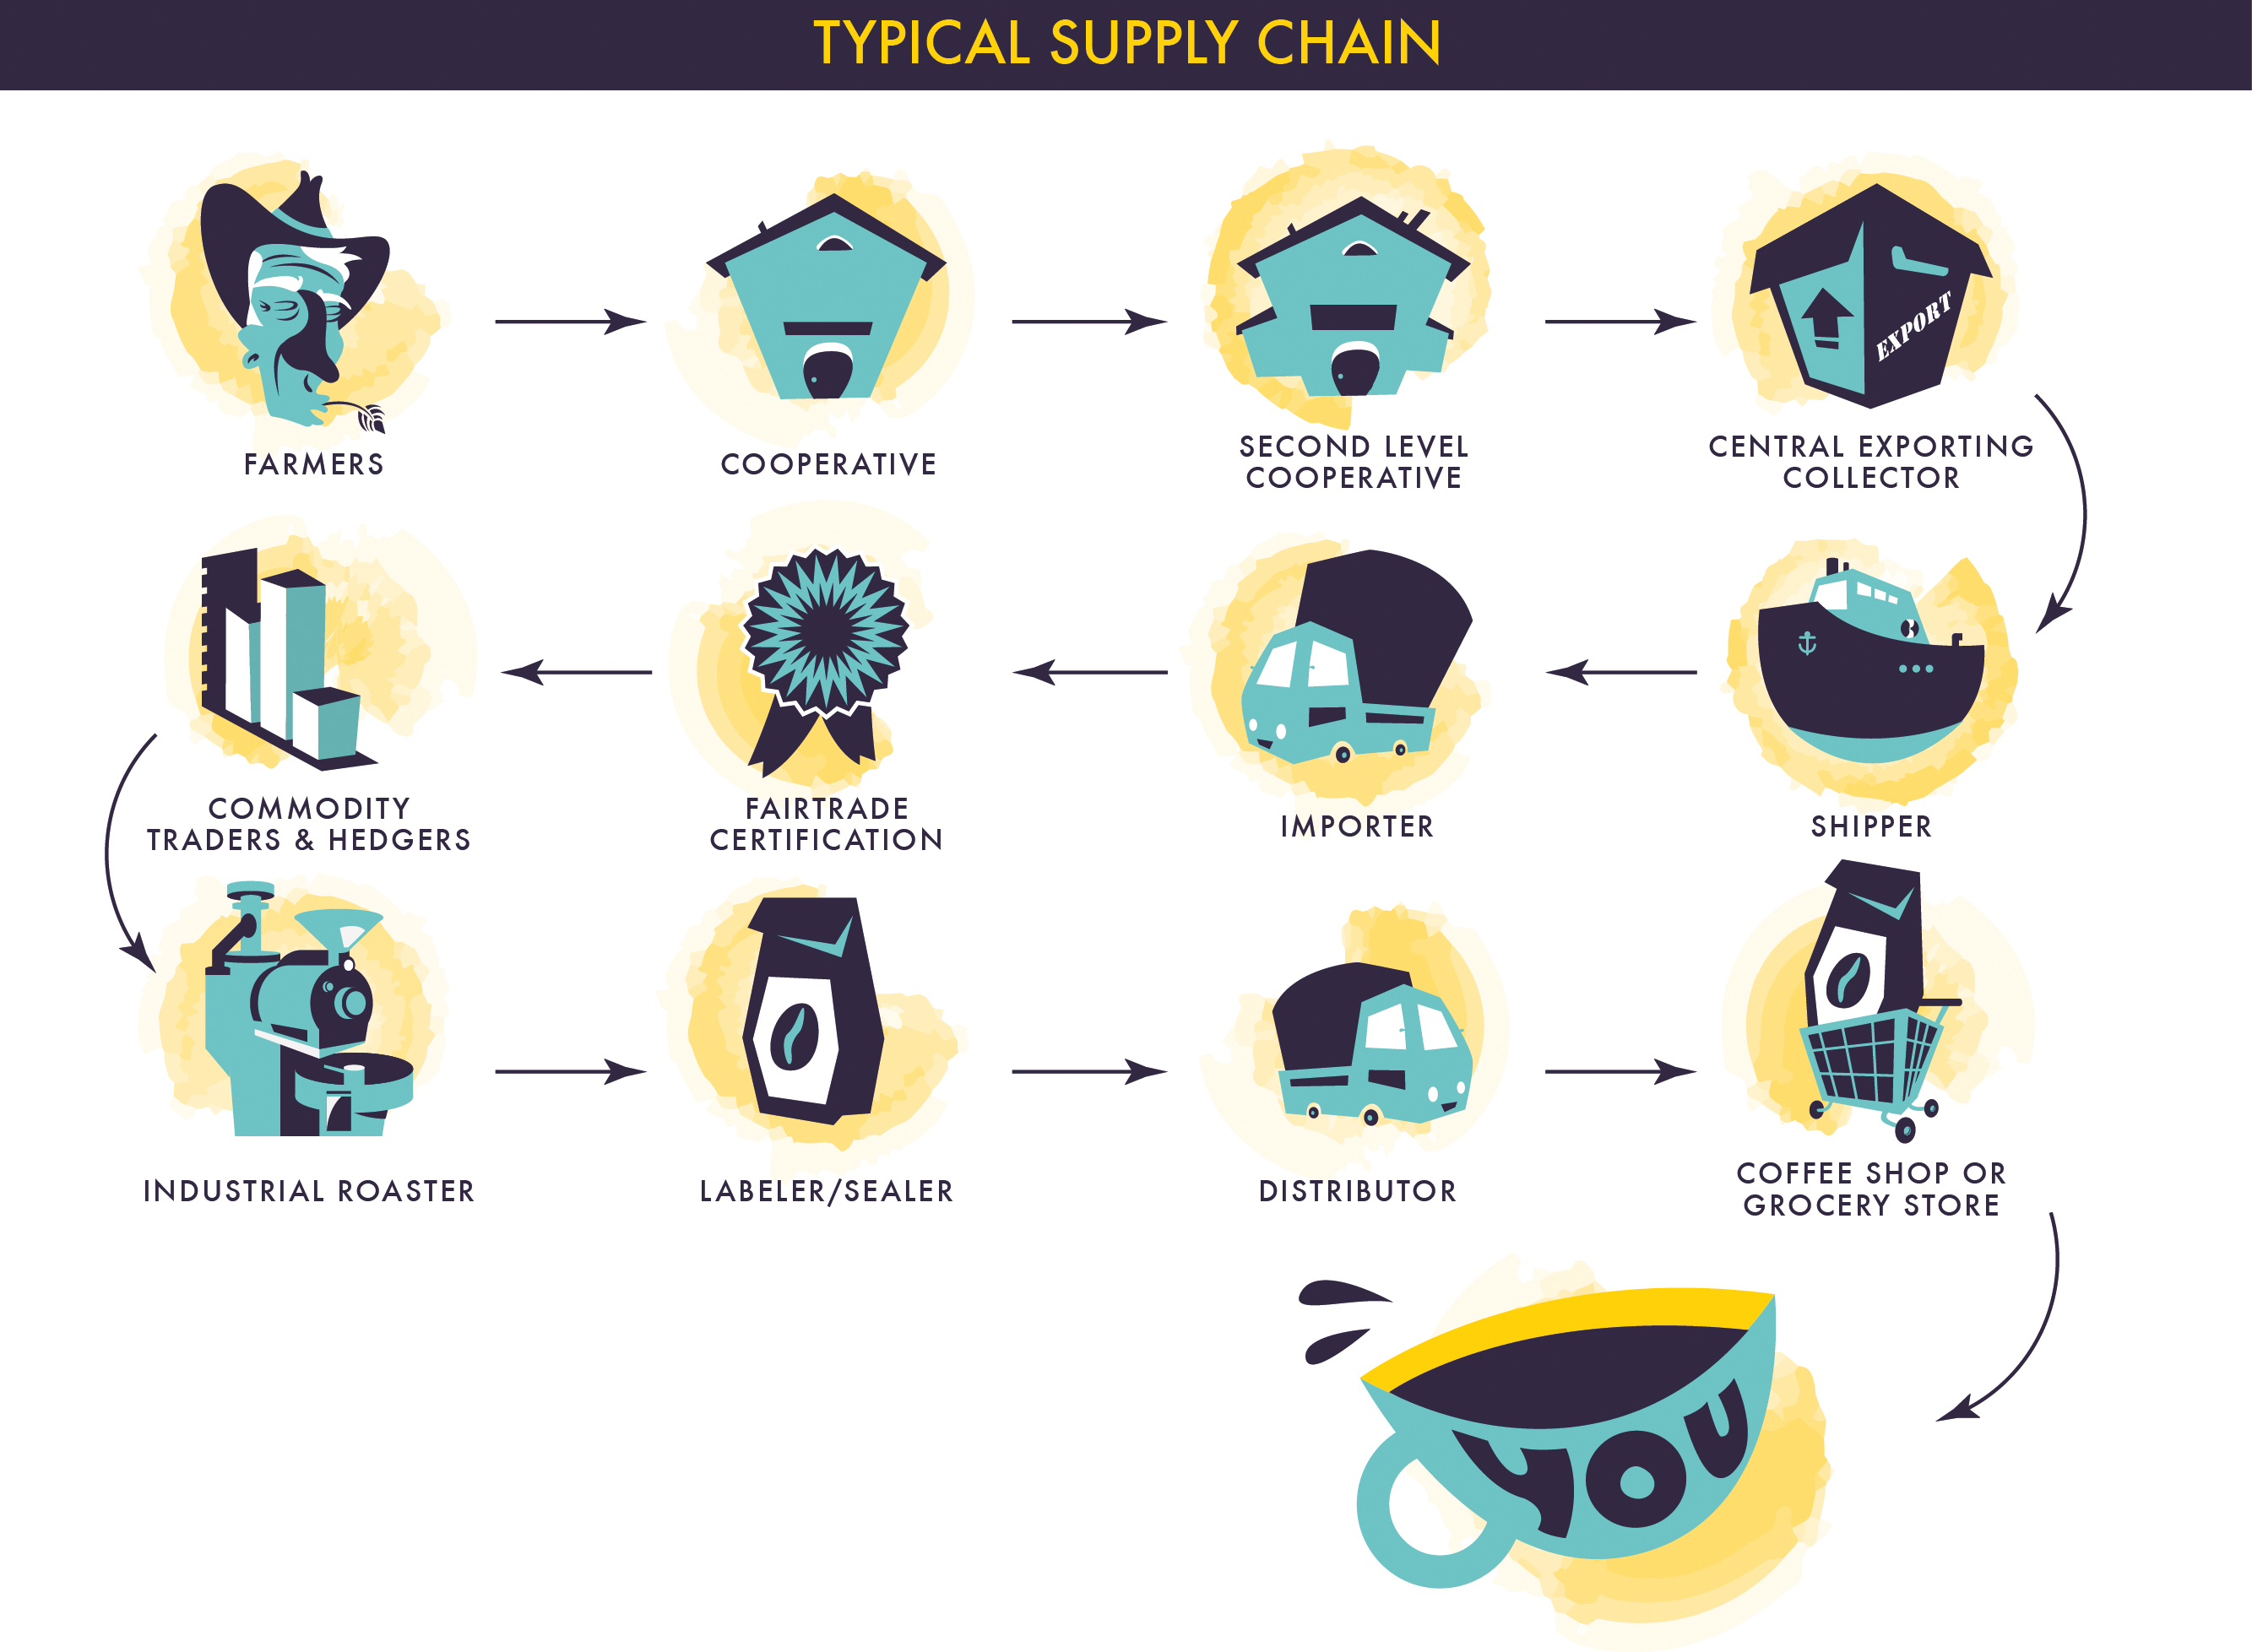
Customer as Keystone

Slide 4
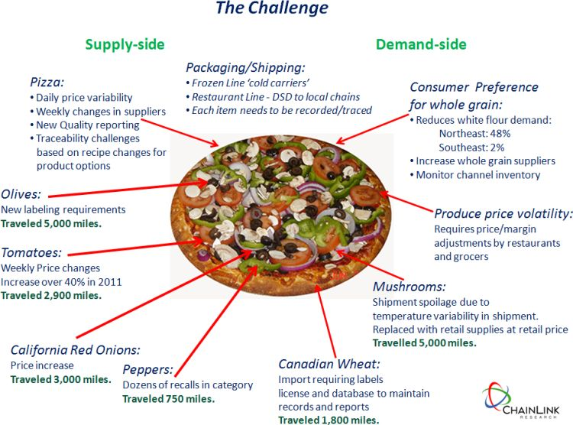
Customer as Keystone

Slide 5
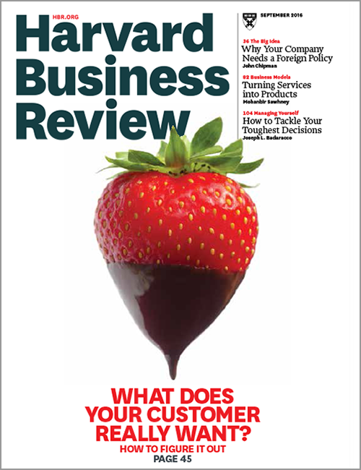
HBR.org; September 2016 issue

Slide 6
The Customer Journey
Sense a need
Search for alternatives
Select some finalists
Shop and buy
Stay or leave
what triggers?
(and levels…)
events? int/ext-ernal?
…
int/ext-ernal?
web? friends?
social media?
tech-sites?
…
optimize? satisfice? what
resources?
constraints?
…
online, onsite?
think/feel/do?
involvement?
time pressure?
…
satisfaction?
loyalty? exit?
voice? evolve?
advocacy?
…
monitor? research? in-out-bound?
ads/buzz/…
SEO/keywords,website, blog… branded apps?
social…
decision-tools? comparison/ review sites… social?
shopper mktg, sales-methods, point-of-purch, ‘sign now’
check-back & follow-up, site to complain, social…
Adapted from most consumer behavior textbooks: ‘the decision making process’

Slide 7
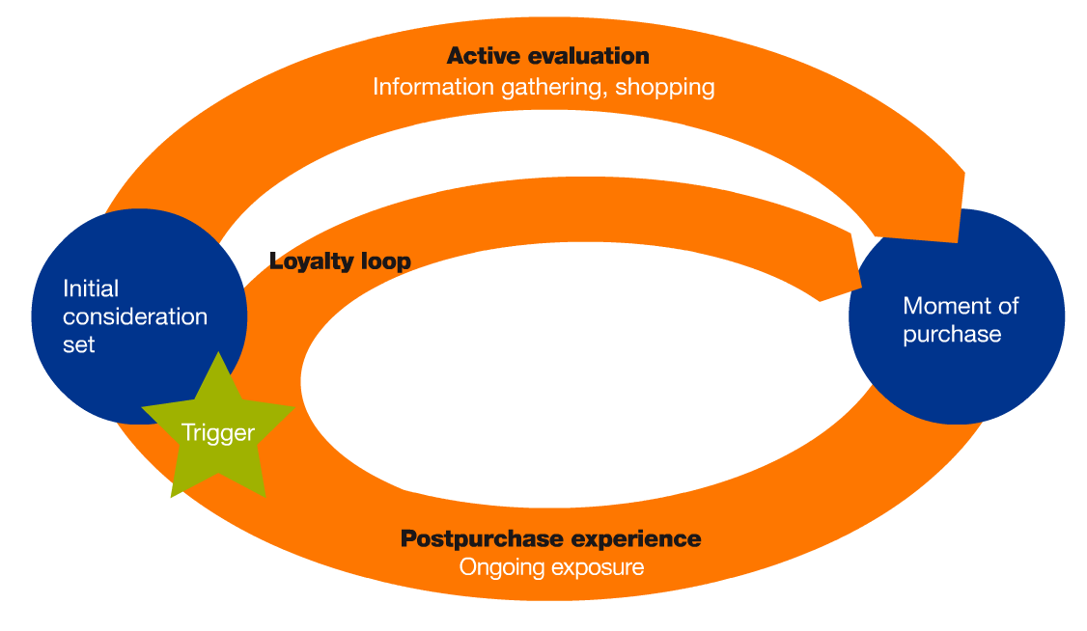
The Customer Journey
Sense a need
Search for alternatives
Select some finalists
Shop and buy
Stay or leave
The World According to Google
ZMOT
FMOT
SMOT
The World According to McKinsey
MckinseyQuarterly.com; ThinkWithGoogle.com

Slide 8
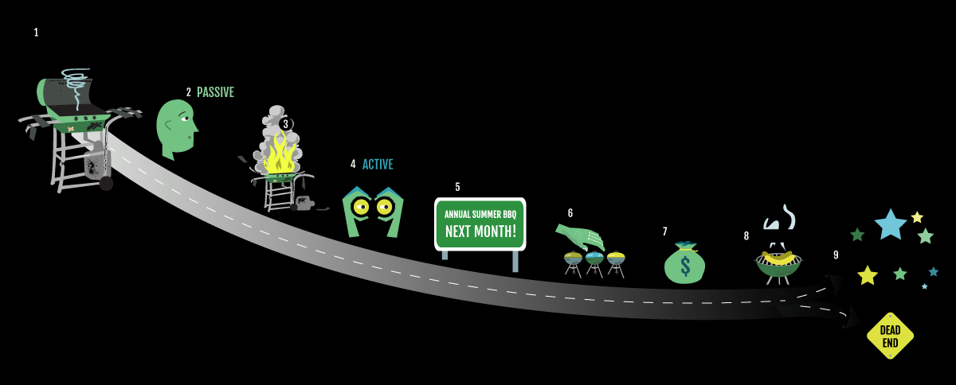
The Customer Journey
Sense a need
Search for alternatives
Select some finalists
Shop and buy
Stay or leave
The World According to Christensen/JTBD

Slide 9
Course Components
Customer Journey Project (team) 10%
Marketing simulation game (team) 10
Book/articles-report, class activity 10
1 per team from a list; TEDlite?
Case Study 10
Class engagement (participation) 10
Core content: textbook quizzes 20
‘old school’, classic formats (online?)
Comprehensive Final Exam 30

Slide 10
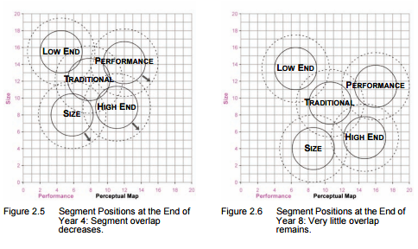

Slide 11
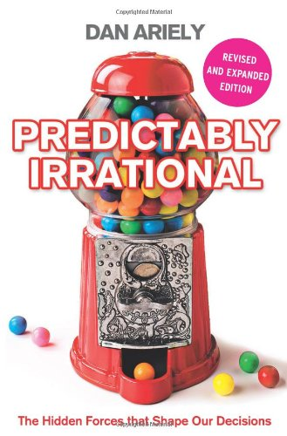
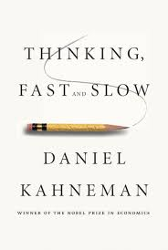
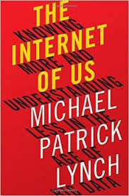


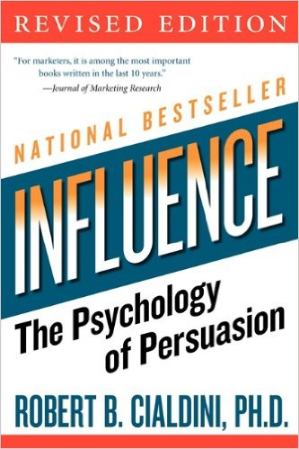
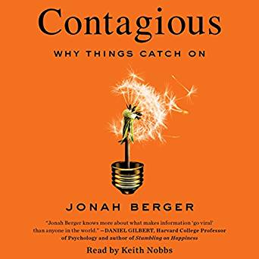

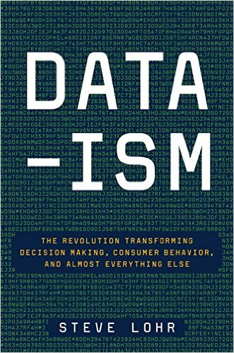

Slide 12
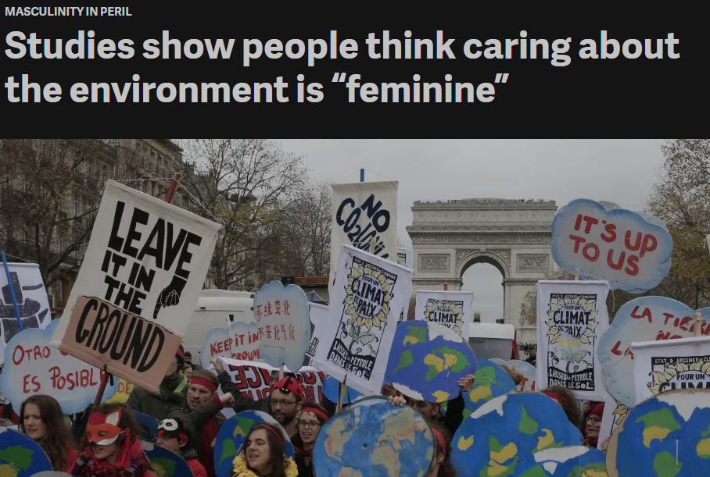
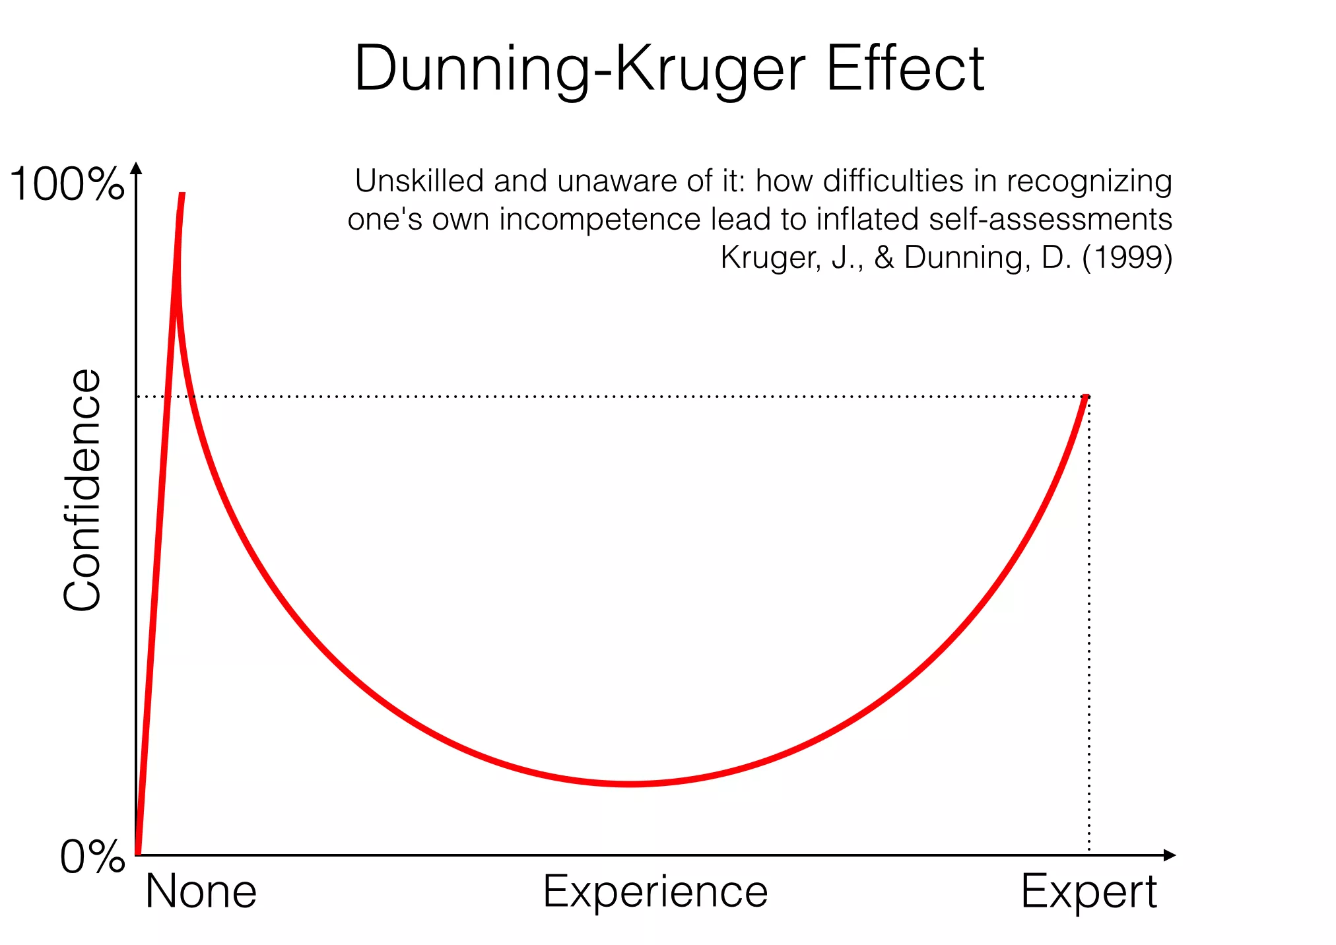
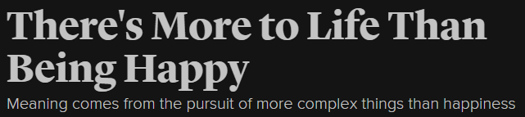

Slide 13
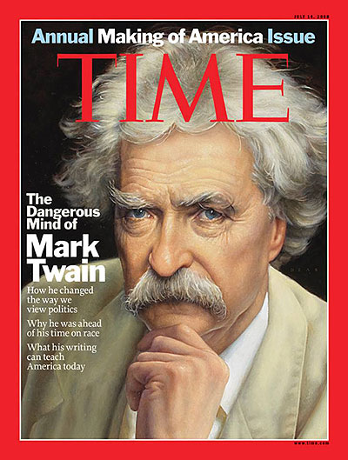
Mark Twain American Adventurer, Wily Intellectual, 1835-1910
It ain't what you don't know that gets you into trouble. It's what you know for sure that just ain't so.
Biography.com; Brainyquote.com;

